Slide 1

BSW – BASIC SOFTWARE
BSW
DCOM
COM
EM
Application Layer
Runtime Environment (RTE)
Basic Software
DCOM
COM
EM
Microcontroller

Slide 2
BSW – BASIC SOFTWARE
BSW
DCOM
COM
EM
NRC | Description
12 | Sub-function is not supported
13 | Incorrect message length or invalid format
78 | Request correctly but response pending
7E | Sub-function is not supported in active diag sessions
33 | Occuring when we haven’t unlocked the security access
7F | When we send service 2E in unsupported session
31 | When we send service 2E with invalid DID or we send service 28 with invalid communication type
22 | When the conditions aren’t correct
24 | Request sequence error
35 | Invalid key
36 | Exceed Number of Attempts. Most of the OEMs will not allow to send wrong key more than 3 times
37 | Required time delay not expired
Sub –function | Description
00 | Use only in tester present mode (Service 3E)
01 | Default session
02 | Programing session
03 | Extended session
Addressing | Description
Physical addressing | Static address of ECU’s
Functional addressing
Terms | Description
DID | Diagnostic Identifier
VIN | Vehicle Identification
DTC | Diagnostic Trouble Code

Slide 3
DCOM
BSW
DCOM
COM
EM
SERVICE | DESCRIPTION
10 | Change Sessions
3E | Tester present
2E | Write DID (Diagnostic Identified)
22 | Read DID
19 | Read DTC (Diagnostic Trouble Code)
14 | Clear DTC
85 | Control DTC
11 | Reset ECU
27 | Security Algorithm
28 | Communication Control

Slide 4
SERVICE 10 – Change Sessions
DCOM
SERVICE 10
SERVICE 3E
SERVICE 2E
SERVICE 22
SERVICE 19
SERVICE 14
SERVICE 85
SERVICE 11
SERVICE 27
SERVICE 28
SERVICE 3E
PROG
SESSION
5s-10s
DEFAULT
SESSION
5s-10s
EXT
SESSION
TESTER
PRESENT
To keep long time !!!
SO SHORTLY TIME !!!
BootLoader
Normally
ECU
Application mode
Wait a few time to BootLoader active
10 02
BootLoader mode
Application mode

Slide 5
SERVICE 10 – Change Sessions
DCOM
SERVICE 10
SERVICE 3E
SERVICE 2E
SERVICE 22
SERVICE 19
SERVICE 14
SERVICE 85
SERVICE 11
SERVICE 27
SERVICE 28
Sub-function | Request | Response
01 | 10 01 | 50 01 xx xx xx xx
02 | 10 02 | 50 02 xx xx xx xx
03 | 10 03 | 50 03 xx xx xx xx
Supported NRC | Example
12 | 10 08 -> 7F 10 12
13 | 10 01 03 -> 7F 10 13
78 | 10 02 -> 7F 10 78, because It takes a few time to active bootloader, we need wait about 100-500ms
7E | … -> 7F 10 7E

Slide 6
SERVICE 3E – Tester Presents
DCOM
SERVICE 10
SERVICE 3E
SERVICE 2E
SERVICE 22
SERVICE 19
SERVICE 14
SERVICE 85
SERVICE 11
SERVICE 27
SERVICE 28
Only supported sub-function 00
TESTER
ECU
3E 00
Tools
OTHER SESSIONS
Keep long time…
DEFAULT SESSION
Panel
7E 00
Supported Addressing
Physical Addressing
Functional Addressing
NRC supported | Example
12 | 3E 01 -> 7F 3E 12
13 | 3E 00 03 -> 7F 3E 13

Slide 7
SERVICE 2E – Write DID
DCOM
SERVICE 10
SERVICE 3E
SERVICE 2E
SERVICE 22
SERVICE 19
SERVICE 14
SERVICE 85
SERVICE 11
SERVICE 27
SERVICE 28
2E F1 90 [DID data]
Supported NRC | Example
31 | 2E AB CD -> 7F 2E 31
13 | 2E F1 90 -> 7F 2E 13
33 | … -> 7F 2E 33
7F | … -> 7F 2E 7F
TESTER
ECU
6E F1 90
F1 90
VIN – Vehicle Identification
Be setted security
Avoid any one can write wrong information to ECU
START
Supported Addressing
Physical Addressing
OEM’s
Change to Ext Session
Unlock Security
Need Unlock security before write DID
Write DID

Slide 8
SERVICE 22 – Read DID
DCOM
SERVICE 10
SERVICE 3E
SERVICE 2E
SERVICE 22
SERVICE 19
SERVICE 14
SERVICE 85
SERVICE 11
SERVICE 27
SERVICE 28
Description | Request | Sample Response
Network information data identifier | 22 F1 20 | 62 F1 20 [4 bytes data]
Function specification data identifier | 22 F1 21 | 62 F1 21 [4 bytes data]
SW Version Number data Identifier | 22 F1 89 | 62 F1 89 [4 bytes data]
HW Version Number data Identifier | 22 F0 89 | 62 F0 89 [4 bytes data]
VIN data Identifier | 22 F1 90 | 62 F1 90 [17 bytes data]
ECU Serial number data Identifier | 22 F1 8C | 62 F1 8C [13 bytes data]
Supported NRC | Example
13 | 22 F1 -> 7F 22 13
31 | 22 AB CD -> 7F 22 31
33 | … -> 7F 22 33
Supported Addressing
Physical Addressing (MAINLY)
Functional Addressing

Slide 9
SERVICE 19 – Read DTC
DCOM
SERVICE 10
SERVICE 3E
SERVICE 2E
SERVICE 22
SERVICE 19
SERVICE 14
SERVICE 85
SERVICE 11
SERVICE 27
SERVICE 28
Sub-functions | Description
01 | Number of active DTC
02 | Actual DTC (active/passive)
04 | DTC snapshot data
06 | DTC extended data
0A | All the DTC in the ECU
Supported NRC | Example
13 | 19 01 09 00 -> 7F 19 13
12 | 19 0E 09 -> 7F 19 12
31 | 19 04 C1 29 87 01 -> 7F 28 31 (DTC: C1 29 87 is not supported)
78 | 19 01 09 -> 7F 19 78, because it takes a few time to active bootloader, we need wait about 100-500ms
Request | Response
19 01 09 | 59 01 [2 bytes number of DTC]
19 02 09 | 59 02 [3 byte DTC] 09
19 04 --- | Be supported base on specific project
19 06 --- | Be supported base on specific project
19 0A 09 | 59 0A [List of all supported DTC] 09

Slide 10
SERVICE 14 – Clear DTC
DCOM
SERVICE 10
SERVICE 3E
SERVICE 2E
SERVICE 22
SERVICE 19
SERVICE 14
SERVICE 85
SERVICE 11
SERVICE 27
SERVICE 28
ECU
14 FF FF FF
(Make sure 4 bytes)
MCU
TESTER
Send clear signal
54
EEPROM
Contain DTC’s
FF FF FF
DTC’s Group
Supported NRC | Example
13 | 14 FF FF -> 7F 14 13
31 | 14 00 00 00 -> 7F 14 31

Slide 11
SERVICE 85 – Control DTC
DCOM
SERVICE 10
SERVICE 3E
SERVICE 2E
SERVICE 22
SERVICE 19
SERVICE 14
SERVICE 85
SERVICE 11
SERVICE 27
SERVICE 28
DTC Setting
DTC Status mask
DTC Status Mask
0 | Test fail
1 | Test fail this operation cycle
2 | Pending DTC
3 | Confirmed DTC
4 | Test not completed since last clear
5 | Test failed since last clear
6 | Test not completed this operation cycle
7 | Warning indicator logic
09
7 | 6 | 5 | 4 | 3 | 2 | 1 | 0
08
7 | 6 | 5 | 4 | 3 | 2 | 1 | 0
01
7 | 6 | 5 | 4 | 3 | 2 | 1 | 0

Slide 12
SERVICE 85 – Control DTC
DCOM
SERVICE 10
SERVICE 3E
SERVICE 2E
SERVICE 22
SERVICE 19
SERVICE 14
SERVICE 85
SERVICE 11
SERVICE 27
SERVICE 28
DTC Setting
DTC Status mask
Sub -function | Description
01 | Start DTC Setting
02 | Stop DTC Setting
Sample Request Testcase | Response | Description
85 02 | C5 02 | Stop DTC setting
timeout | - | Make a fault
19 02 09 | 59 02 [DTC data] 01 | DTC setting is stopped, so DTC confirm bit is set low level. DTC test fault bit is set high level because of fault.
85 01 | C5 01 | Start DTC setting
19 02 09 | 59 02 [DTC data] 09 | DTC setting is started, so DTC confirm bit is set high level. DTC test fault bit is set high level because of fault.

Slide 13
SERVICE 11 – Reset ECU
DCOM
SERVICE 10
SERVICE 3E
SERVICE 2E
SERVICE 22
SERVICE 19
SERVICE 14
SERVICE 85
SERVICE 11
SERVICE 27
SERVICE 28
Sub-function | Description | Request | Response
01 | Hard reset | 11 01 | 51 01
02 | Key off on reset | 11 02 | 51 02
03 | Soft reset | 11 03 | 51 03
Supported NRC | Example
13 | 11 01 00 -> 7F 11 13
12 | 11 00 -> 7F 11 12
33 | … -> 7F 11 33
22 | … -> 7F 11 22
Modes | Detail description
Hard reset | Power-on/Start-up after the server has been previously disconnected from its power supply.
Key off on reset | When driver turns the ignition key off and back on.
Soft reset | The soft-reset value causes the server to immediately restart the application program if applicable.

Slide 14
SERVICE 27 – Security Algorithm
DCOM
SERVICE 10
SERVICE 3E
SERVICE 2E
SERVICE 22
SERVICE 19
SERVICE 14
SERVICE 85
SERVICE 11
SERVICE 27
SERVICE 28
FORMULA
Key = [4 bytes of seed] + 00 00 4E 87
Key1
ECU
Supported NRC | Example
13 | 27 01 00 -> 7F 27 13
12 | 27 02 -> 7F 27 12
24 | … -> 7F 27 24
35 | 27 02 ZZ ZZ ZZ ZZ -> 7F 27 35
36 | … -> 7F 27 36
37 | After 3 wrong attemps, the ECU will response NRC 36, we need wait about 10min or 10 sec based on OEMs to send 27 01 again. If we don’t comply with this rule, we will receice 7F 27 37 (NRC 37)
3
Use formula
1
Request a seed [4 bytes]
3
Seed
ECU
Response a seed [4 bytes]
TESTER
2
Formula
Send Key1 for compare
Key1
Key2
4
Compare
same
5
not same
Response this message
6
OK
NRC 35
Request | Response
27 01 | 67 01 XX XX XX XX
Key [ YY YY YY YY ]= XX XX XX XX + 00 00 4E 87
27 02 YY YY YY YY | 67 02

Slide 15
SERVICE 28 – Communication Control
DCOM
SERVICE 10
SERVICE 3E
SERVICE 2E
SERVICE 22
SERVICE 19
SERVICE 14
SERVICE 85
SERVICE 11
SERVICE 27
SERVICE 28
MESSAGE FORMAT [3 BYTES]
28 | XX | YY
Service | Sub-function | Communication type
28 XX YY
TESTER
ECU
68 XX
Sub-functions | Enable TX | Disable TX
Enable RX | 00 | 01
Disable RX | 02 | 03
Supported NRC | Example
13 | 28 03 01 00 -> 7F 28 13
12 | 28 04 -> 7F 28 12
31 | 28 03 00 -> 7F 28 31
7F | … -> 7F 28 7F
Com type | Description
01 | Normal communication message
02 | Network management communication message
03 | 01 + 03

Slide 16
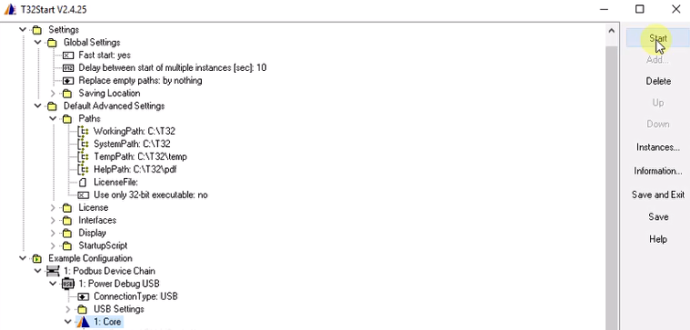
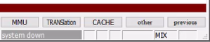
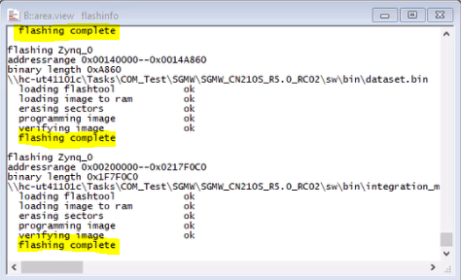
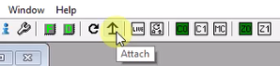
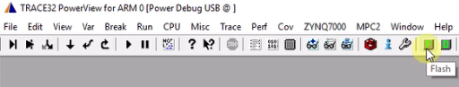
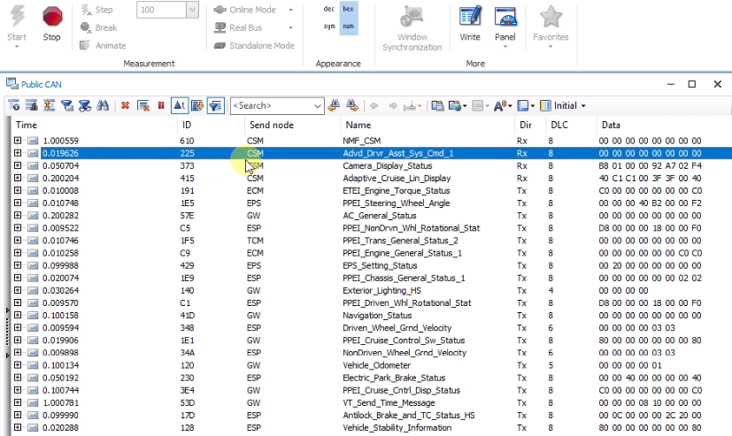
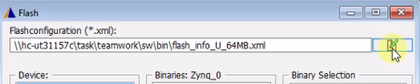
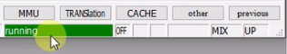
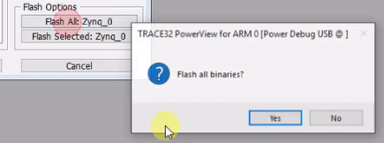
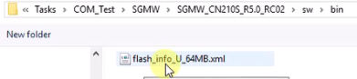
BSW
DCOM
COM
EM
COM
Flash software
1. Start “Trace32 Start” tool.
3. Check system power status
4. All complete, check Rx, Tx signals in coresi
3.1. In case power down, check power supply then chose attach
2. Chose “Flash” tool and select flash file.
3.2. After entering running mode Flash all binaries

Slide 17
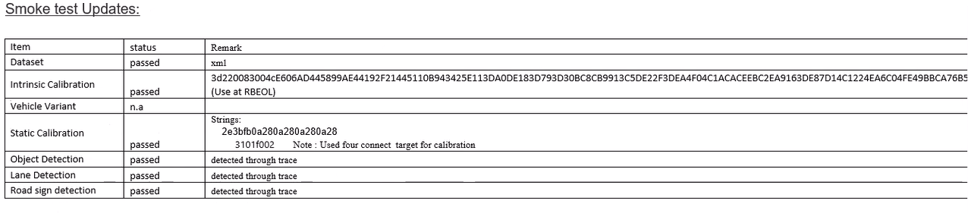
BSW
DCOM
COM
EM
COM
Configuration for Calibration (1/3)
Dataset:
Intrinsic Calibration: message use at RBEOL mode UDS format [3d][22][data] = [service function][sub-function][data]
Vehicle Variant: select variants
Static Calibration: used before enabling SUMO, TRAMO messages – need screen for calibration
*NOTE:
- UDS: Unified Diagnostic Services. A standard for Diagnostics according to ISO14229-1

Slide 18
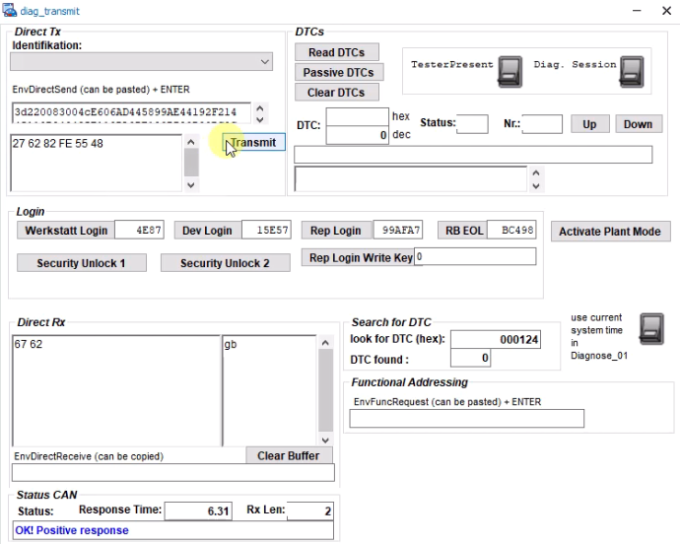
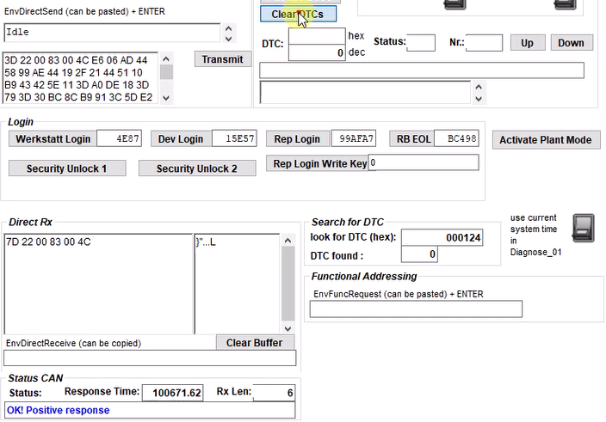
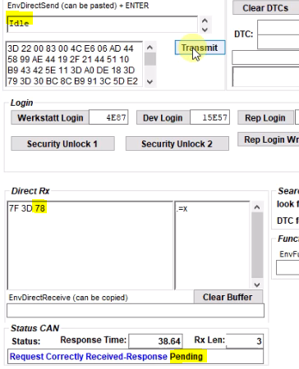
BSW
DCOM
COM
EM
COM
Configuration for Calibration (2/3)
Click “Activate Plant Mode”
Chose “RB EOL“mode
Check wherther Direct Rx have value and Status is “OK”
Enter the EnvDirectSend gotten from the released email then Click “Transmit”. Transmit success: “OK! Positive response”
Click Clear Idle mode Direct Rx end with “78” (Pending)
4
2
1
5
3

Slide 19
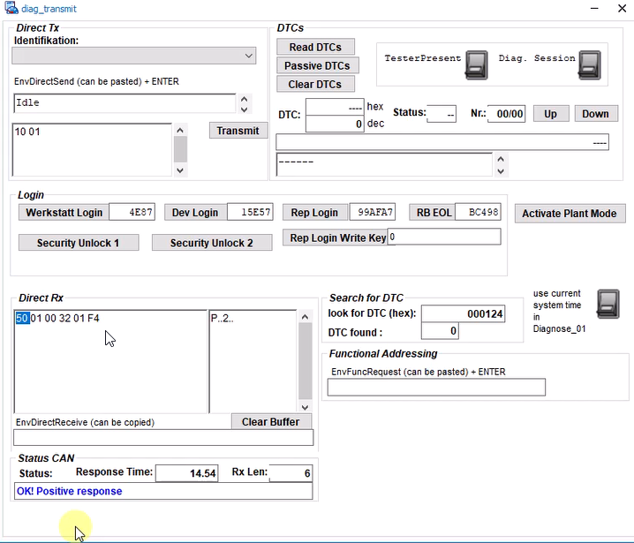
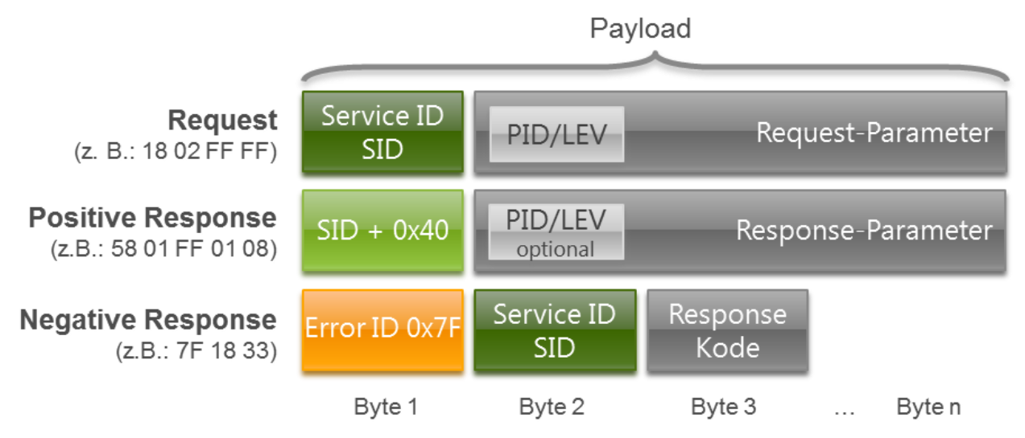
BSW
DCOM
COM
EM
COM
Configuration for Calibration (3/3)
EnvDirectSend (Physical request)
Basic sections:
- Using service 10 (section control) for changing sections
- Sub-function:
01: Default section
02: Programing section
03: Extending section.
Direct Rx (respond from MPC)

Slide 20
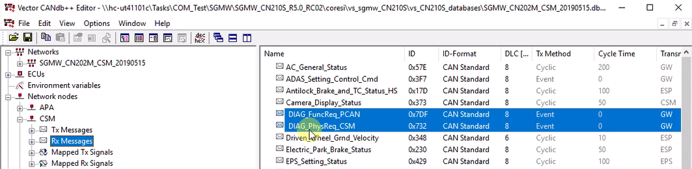
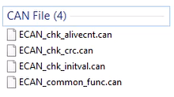
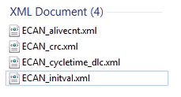
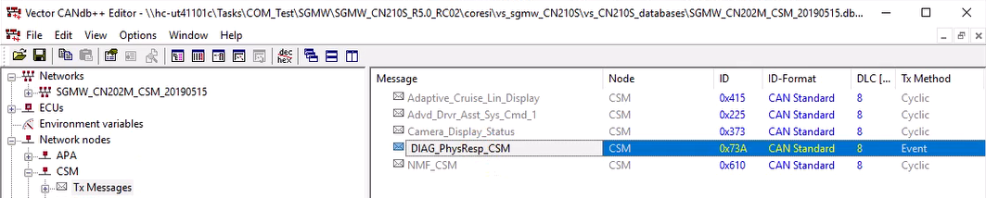
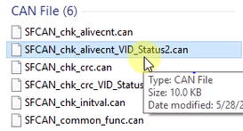
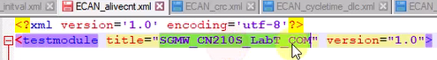
BSW
DCOM
COM
EM
COM
Automation test (1/8)
Folder structure
Define MPC node
ECAN files
SFCAN files
Common xml modification
Correct the title for project name export in report file
NOTE:
*VID_Status2.can has different testWaitForTimeout get signal
Please refer VID cycle time in DBC file for more detail.

Slide 21
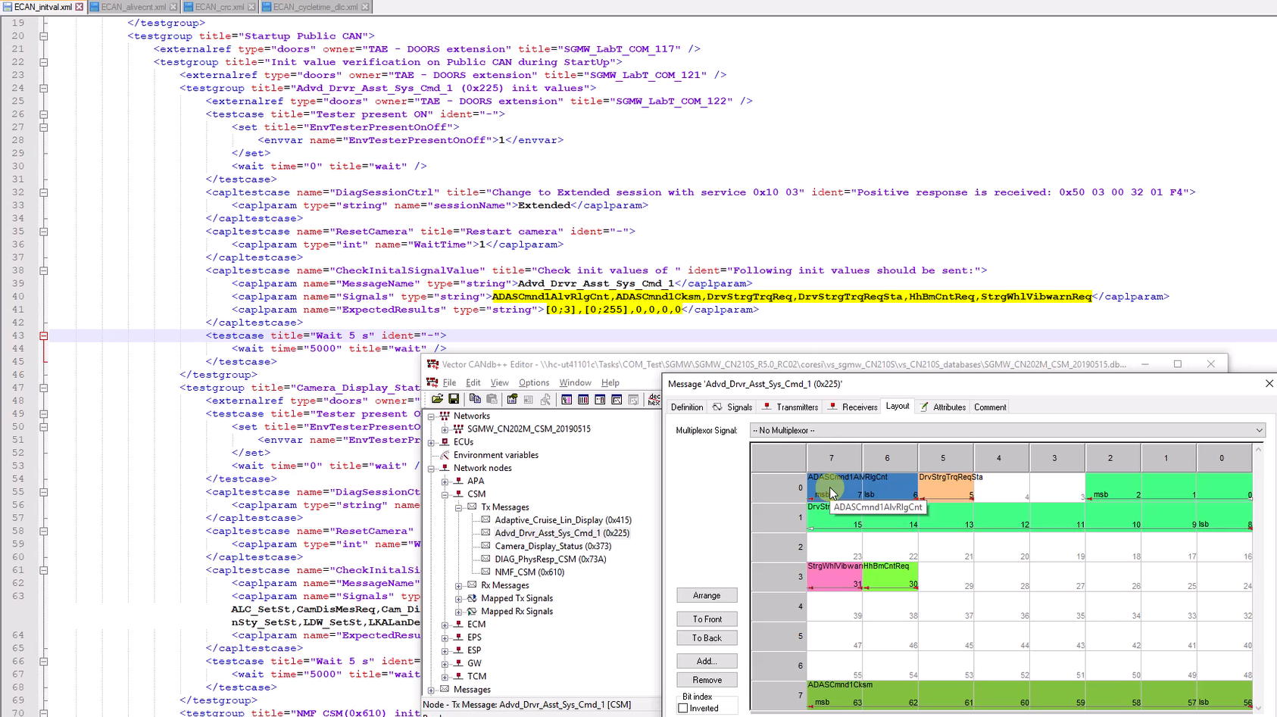
BSW
DCOM
COM
EM
COM
Automation test (2/8)
All ECAN’s xml files must describe all messages and correct bits allocation and size (initial and range of values)

Slide 22
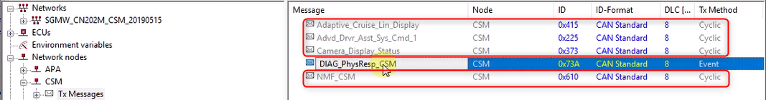
BSW
DCOM
COM
EM
COM
Automation test (3/8)
ECAN will check all the MPC’s messages in Tx Messages except DIAG_PhysResp_MPC related to CAN transport

Slide 23
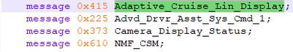
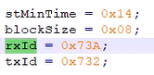
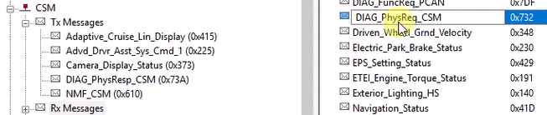
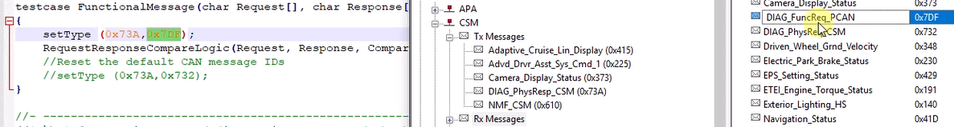
BSW
DCOM
COM
EM
COM
Automation test (4/8)
Common function: ECAN_common_func.can
ECAN will check all the MPC’s messages in Tx Messages except DIAG_PhysResp_MPC which was related to CAN transport
The value usually 0x7DF

Slide 24
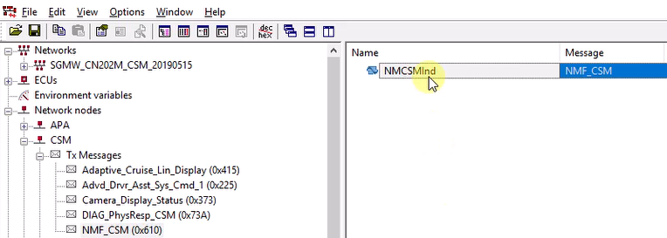
BSW
DCOM
COM
EM
COM
Automation test (5/8)
Ways to check:
1. Check inside messages
2. Check layout
3. Check Maximum values:
Checksum (0-255)
Alive counter 2bit (0-3) 3bit (0-7)
Alive counter function: ECAN_chk_alive.can
Adding messages which includes alive counter inside.
In this example, NMCSMlnd don’t have alive counter.

Slide 25
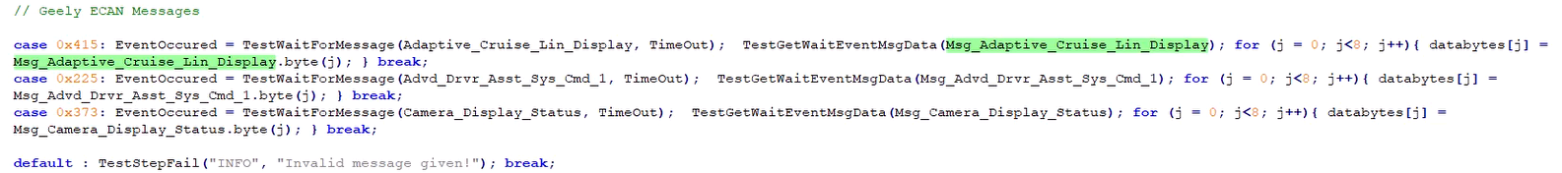
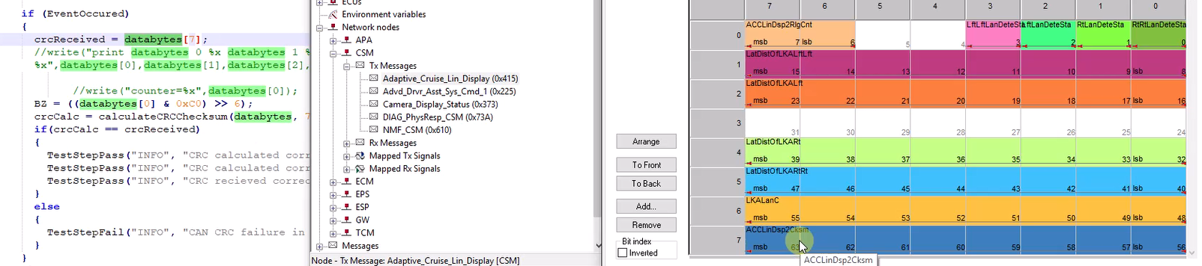
BSW
DCOM
COM
EM
COM
Automation test (6/8)
Checksum function: ECAN_chk_crc.can
Adding “Msg_” before messages which includes checksum inside.
Modifying Messages based on format and correcting “databytes” using layout.
*NOTE: crcReceived: get from system
crcCalc: using formula to calculate.
Using masking for alive counter (BZ)

Slide 26
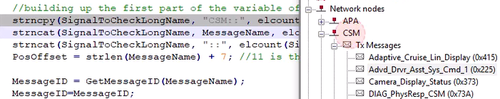
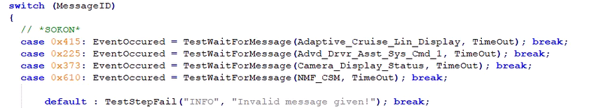
BSW
DCOM
COM
EM
COM
Automation test (7/8)
Initial value function: ECAN_chk_initval.can
Modify the main note. Addition length = MPC’s + 4
For this instance, it is CSM and addition length is 7
2. Modifying Messages ID full message except DIAG_

Slide 27
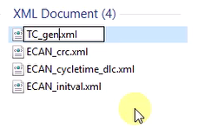
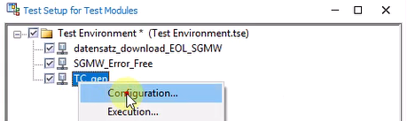
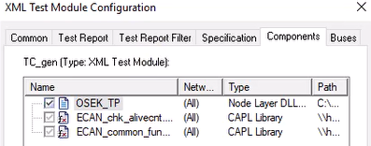

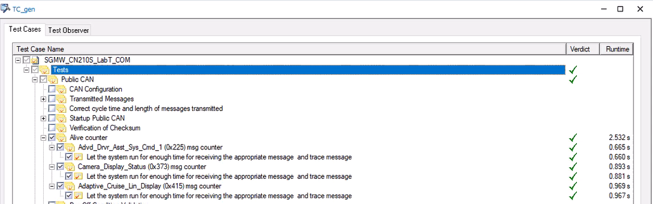
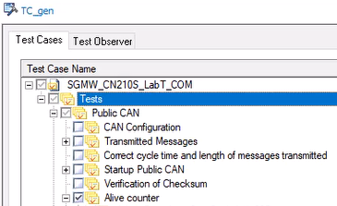
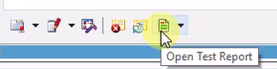
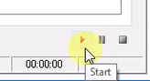
BSW
DCOM
COM
EM
COM
Automation test (8/8)
Download test scripts in tag “Testnote” (Coresi):
Step 1: Due to many components, define a common format add it to Test Environment. E.g: TC_gen.xml for chk_alivecnt
Step 2: Select “Configuration”
Step 3: In components tag, add *.can file include files: <Test_case>.can, <Common>.can, osek_tp.dll (C:\Program Files\Vector CANoe 10.0\Exec32\osek_tp.dll)
Step 4: Start coresi then select test cases, kick start button then check the results.
Step 5: Click start button “|>” then check the results.
Step 6: Open the Test Report.
1
2
3
5
4

Slide 28
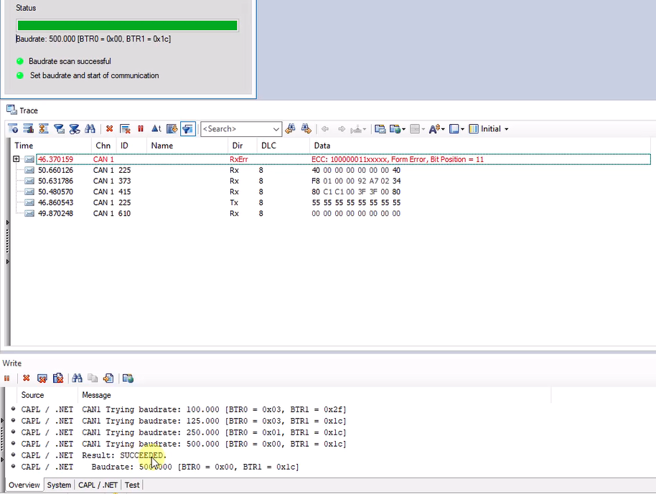
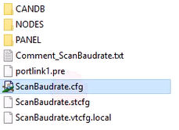
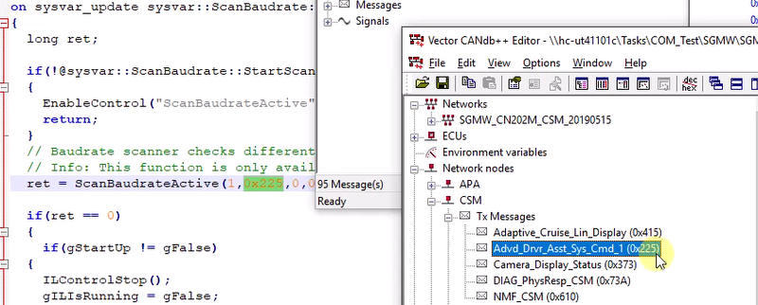
BSW
DCOM
COM
EM
COM
Manual test cases
– Need to modify TestSteps, Test response, Teststep keywords
Result:
Baudrate – Scan Baudrate
1: Public CAN
2: Private CAN
0x225 ID of message

Slide 29
BSW
DCOM
COM
EM
COM
Manual test cases
Sampling point: Need CAN Stress or CAN Disturbance
1: Public CAN
2: Private CAN
0x225 ID of message

Slide 30
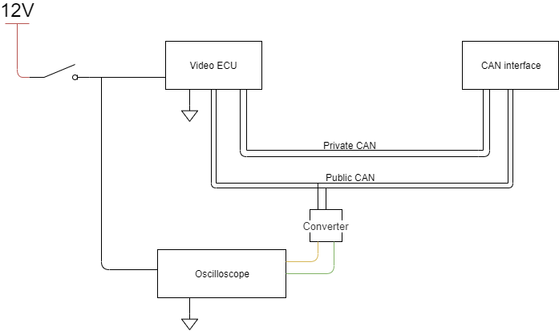
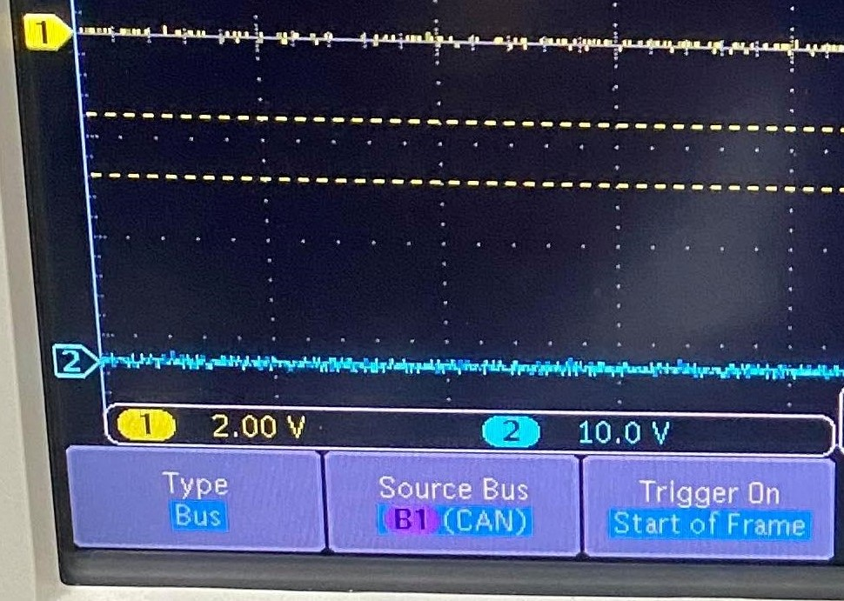
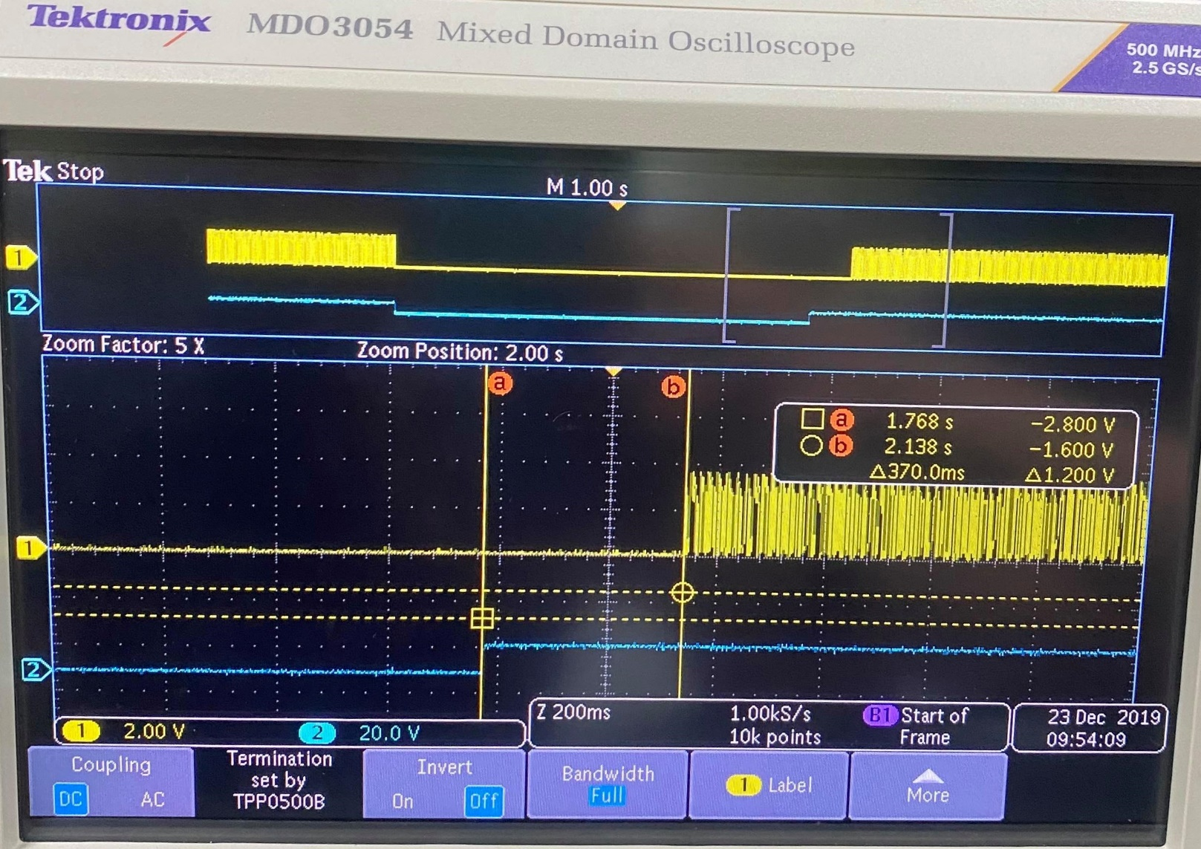
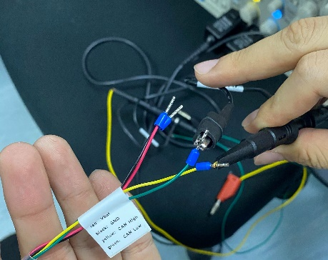
BSW
DCOM
COM
EM
COM
Manual test cases
Procedure:
Connect Hardware
Setup Oscilloscope
Shut the power down then turn it on
Press “RUN/STOP” to “RUN/STOP”
Adjust the start point of power and signal
Check the Δtime then compare to requirement
Start up time
Set up Oscilloscope:
Type: Bus
Source Bus: B1 (CAN)
Trigger On: Start of Frame
Power signal:
Yellow: CAN high
Green: CAN low

Slide 31
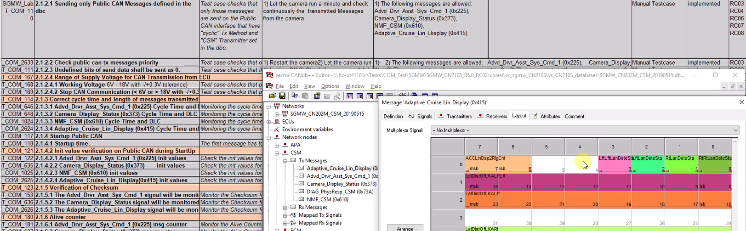
BSW
DCOM
COM
EM
COM
Manual test cases
Sending only Public CAN Messages defined in the dbc
Undefined bits of send data shall be sent as 0 (1/2)
1st Method: Open the message layout then check the un-used (reserved) bits are 0 or 1

Slide 32
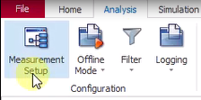
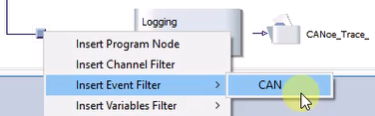





BSW
DCOM
COM
EM
COM
Manual test cases
Sending only Public CAN Messages defined in the dbc
Undefined bits of send data shall be sent as 0 (1/2)
2nd Method: checking log files
Step 1: Setup Logging, select the message need to be filtered
Step 2: Chose the stored folder, record then check the log files.

Slide 33
BSW
DCOM
COM
EM
COM
Manual test cases
Check public CAN Tx messages priority
Step 1: Filter all public CAN Tx messages
Step 2: Start then logging record
Step 3: Reset CAN “1101”
Step 4: Check the first message (ID) sent after error frame (which was created by resetting) is end
Working Voltage (8V - 18V with -/+0.3V tolerance)
Step 1: Filter all public CAN Tx messages
Step 2: Start then logging record
Step 3: Reset CAN “1101”
Step 4: Check the first message (ID) sent after error frame (which was created by resetting) is end

Slide 34











BSW
DCOM
COM
EM
COM
Manual test cases
Enable XCP communication over Extended CAN
1. Add frame from database move it to trace window then Tester present ON - Change to Extended session with service 0x10 03
2. Tester present ON - Change to Extended session with service 0x10 03
3. Check DTO is disable then try to enable it using message “2E 05 30 80”
62 05 30 00 Disable
62 05 30 80 Enable
Service 22 read
Service 2E write

Slide 35



BSW
DCOM
COM
EM
COM
Manual test cases
Disable XCP communication over Extended CAN
1. Change the sent data
2. Check DTO is enable then try to disable it using message “2E 05 30 00”
When disable mode when changing sent data, DTO won’t receive messages.
62 05 30 00 Disable
62 05 30 80 Enable
Service 22 read
Service 2E write

Slide 36






BSW
DCOM
COM
EM
COM
Manual test cases
Data Frame(Standard and Extended Frame) - (Diagnostic Trouble Code)
1. Change the type to “CAN Extended” save the dbc, restart the coresi then check DTCs (Clear and Read DTCs)
2. Check the feedback status is active state with extended frames’ messages –take picture for report
Format of Read DTCs contain Failure
<0x59> <02 4B> <E8 00 87> <0B>
<Service> <Subfunc> <DTC> <status>
Passive state - can be cleared
e.g: 0A = 1010 passive state (last bit =0)
Active state – failure communication
e.g: 0B = 1011 active state (last bit =1)

Slide 37




BSW
DCOM
COM
EM
COM
Manual test cases
Remote Frame (Consists of all the fields except data field; RTR bit is recessive)
1. In CAN IG change add message then select CAN Remote Type then setting logging for record
Press the keyword set in manual e.g: “z”
2. Open log file then check whether the remote message (no data fields) sent correctly or not.

Slide 38




BSW
DCOM
COM
EM
COM
Manual test cases
No Acknowlegement
In “Hardware” tag select “Network Hardware” then chose the “ACK Off” in CAN 1 (public)
2. Check the signal, Data should show the error (Not Acknowlegement)

Slide 39





BSW
DCOM
COM
EM
COM
SOME ISSUES AND SOLUTIONS
Reset ECU
1101
Result

Slide 40


BSW
DCOM
COM
EM
COM
SOME ISSUES AND SOLUTIONS
Wrong initial values
Reset then re-execute these cases if the initial values were wrong, you should confirm these values with the developers.

Slide 41
BSW
DCOM
COM
EM
COM
SOME ISSUES AND SOLUTIONS
SFCAN VID case (last case) failed:
Please check the whether you are using *VID_Status2.can and testWaitForTimeout get signal
Please refer VID cycle time in DBC file for more detail.
Result

Slide 42
EM
BSW
DCOM
COM
EM
BASIC TEST
QUALIFICATION AND HEALING TIME TEST
Create an error, corresponding DTC will be reported
Create an error, DTC will be reported after qualification time
Remove error, DTC will become history DTC
Remove error, DTC will become history DTC after healing time
Error Management Test
Loss Communication
Alive counter error
Checksum error - CRC
Signal
invalid
Data length error - DLC
DTC Types

Slide 43

EM
BSW
DCOM
COM
EM
FOCUS

Slide 44
LOSS COMMUNICATION
EM
TO
CRC
BZ
DLC
INVALID VAL
CAN Protocol
TX NODE
TX NODE
2
1
TX NODE
RX NODE
TX NODE
1
1
Loss communication
2
2
2
2
Normally communication
TX NODE
TX NODE

Slide 45

CHECKSUM
EM
TO
CRC
BZ
DLC
INVALID VAL
In order to warrant QUALITY of data field of some essential messages, customer defined a
CRC Sequence in DATA FIELD of those ones.
64 bits Data field
CRC Sequence
0 – 8 bits
TX NODE
RX NODE
Data frame
Data and security correct
CRC Sequence is calculatored before data frame transmited
Yes
CRC Sequence is calculatored after data frame receivered
Equal ?
No
Reported CRC fault

Slide 46
ALIVE COUNTER
EM
TO
CRC
BZ
DLC
INVALID VAL
In order to warrant SECURITY of data field of some essential messages, customer defined a ROLLING COUNTER SIGNAL in DATA FIELD of those ones.
Alive counter data
The data length is based on specific message.
TX NODE
RX NODE
Data frame
When a message is transmitted successfully
BZ is correct
When a message is received successfully
Yes
txCnt++ txCnt<16
Equal ?
rxCnt++
rxCnt<16
No
Reported BZ fault

Slide 47
DATA LENGTH CODE
EM
TO
CRC
BZ
DLC
INVALID VAL
Message frame
The data length is maximum 8 bytes.
Coresi is simulated to transmit 7 bytes data
TX NODE
RX NODE
Data frame
DLC is correct
Yes
Initial: 8 bytes data
Equal ?
Miss 1 byte LSB
No
Reported DLC fault

Slide 48
INVALID VALUE
EM
TO
CRC
BZ
DLC
INVALID VAL
DATA FIELD
0 – 8 bytes (MSB --- LSB)
Using the coresi to config signal value
TX NODE
RX NODE
Data frame
Data value is set in data frame
Signal value is correct
Yes
In of range ?
COMPARE
Reported invalid value fault
No
SOFTWARE
Signal Values are defined
in of Range

Slide 49








CORESI RESTBUS
HOME
CORESI
Step 1
Step 2
Step 3
Step 4
Step 5
Step 6
Step 7
Step 8
Step 9
WHAT WE NEED BEFORE START ?
.dbc file
Gen-tool
Gen-tool\dbc
Gen-tool\source
Source\coresi
Source\generate
pubc_cola
GEN - TOOL
Coresi
Vs_HMAC_VF00
CORESI

Slide 50


CORESI RESTBUS
HOME
CORESI
Step 1
Step 2
Step 3
Step 4
Step 5
Step 6
Step 7
Step 8
Step 9
Step 1: Open Gen-tool\dbc forder, copy file .dbc to this forder, open this file, right-click to MPC , export to file .xml, and save file .xml in the same location of .dbc

Slide 51


CORESI RESTBUS
HOME
CORESI
Step 1
Step 2
Step 3
Step 4
Step 5
Step 6
Step 7
Step 8
Step 9
Step 2: Choose Signals, then choose File\Export\Export List of Objects and save file .csv in the same location of file .xml

Slide 52



CORESI RESTBUS
HOME
CORESI
Step 1
Step 2
Step 3
Step 4
Step 5
Step 6
Step 7
Step 8
Step 9
Step 2: Choose Signals, then choose File\Export\Export List of Objects and save file .csv in the same location of file .xml . After that, edit .csv file as below:
Open .csv file, you can see it’s so difficult to follow. You must change its format. So, firtly you need choose all contents and Ctrl+C
Then you must Ctrl+V to copy all contents to nodepad++. You can see digit {“}. So, you must delete all {“}, replace by ‘space’ , Ctrl+A to choose all contents and Ctrl+C.
Then you overwrite this contents to .csv file by Ctrl+V. You can see it’s so easily to follow.

Slide 53


CORESI RESTBUS
HOME
CORESI
Step 1
Step 2
Step 3
Step 4
Step 5
Step 6
Step 7
Step 8
Step 9
Step 3: We need modify contents in source forder. I will show you what’re contents need to modified?
3.1. Open location source\coresi_geely\coresi_geely_pubcan\pubc_coresi_geely_cola and
source\generator_cola , you need modify highlighted file as below:
.cola file
.ini file
Checksum
Counter
CRC function
Location of .xml file
Modification overview
.lis file
.bat file
Main Node names
Location of python application file

Slide 54


CORESI RESTBUS
HOME
CORESI
Step 1
Step 2
Step 3
Step 4
Step 5
Step 6
Step 7
Step 8
Step 9
Step 3: We need modify contents in source forder. I will show you what’re contents need to modified?
3.2. You need fix two .lis files firstly. How you know the main node is what? You can search it as below:
MPC
2
Open .dbc and check all message one by one
3
1
Node have this messages is main Node
Modify to:

Slide 55

CORESI RESTBUS
HOME
CORESI
Step 1
Step 2
Step 3
Step 4
Step 5
Step 6
Step 7
Step 8
Step 9
Step 3: We need modify contents in source forder. I will show you what’re contents need to modified?
3.3. Next, you need fix two .ini files. You must copy .xml name and replace to busfile link in .ini files

Slide 56

CORESI RESTBUS
HOME
CORESI
Step 1
Step 2
Step 3
Step 4
Step 5
Step 6
Step 7
Step 8
Step 9
Step 3: We need modify contents in source forder. I will show you what’re contents need to modified?
3.4. Next, you need fix two .bat files.
Check version of Python
Run OK ?
Yes
Next step
No
Replace by python link in C:\ismPython\V3_3_2 or the others base on your computer

Slide 57


CORESI RESTBUS
HOME
CORESI
Step 1
Step 2
Step 3
Step 4
Step 5
Step 6
Step 7
Step 8
Step 9
Step 3: We need modify contents in source forder. I will show you what’re contents need to modified?
3.5. And then, you need fix all .cola files (6 files).
- (1) We will focus to find messages which contain checksum and counter. So, How we do it? We open .csv file , filter by name the “name” column, check by keyword “checksum or counter or similar words such as crc, chksum, cnt, alivecnt, alivecounter,….” . Example, I check messages which contain checksum, you do with “counter” similarly.
Another tip check quickly checksum and counter signals
.*?Checksum.*?
Checksum.*?
.*?Checksum$
‘Or logic’ all components together
Create new script and write be like it.
.*?CheckSum$
.*?Checksum$|.*?CheckSum$|Checksum.*?|.*?Checksum.*?
*Note: Checksum # CheckSum

Slide 58

CORESI RESTBUS
HOME
CORESI
Step 1
Step 2
Step 3
Step 4
Step 5
Step 6
Step 7
Step 8
Step 9
Step 3: We need modify contents in source forder. I will show you what’re contents need to modified?
3.5. And then, you need fix all .cola files (6 files).
- (2) Next, we will focus to overwrite new checksum counter strings. So, firstly we need Ctrl+F to search “WHERE name” location, we will see the old checksum counter strings. After that, we copy the new one which’re created in previous slide(page 26) and replace its to suitable location. Example, I will modify the file below:
We can see:
1 location contains checksum
3 locations contain alive counter
8 locations contain both checksum and counter
New strings
*Note: - ‘?!’ means ‘NOT’, attend it.
- Check again after modify

Slide 59



CORESI RESTBUS
HOME
CORESI
Step 1
Step 2
Step 3
Step 4
Step 5
Step 6
Step 7
Step 8
Step 9
Step 3: We need modify contents in source forder. I will show you what’re contents need to modified?
3.5. And then, you need fix all .cola files (6 files).
- (3) We will focus to change the checksum functions, the counter functions and formula calculators crc in file source\coresi_geely\coresi_geely_pubcan\pubc_coresi_geely_cola\capl_code_cangen_geely.cola. To do it, we base on developer requirements and previous released coresi.
Checksum func ()
Counter func ()
Calculator crc func()

Slide 60

CORESI RESTBUS
HOME
CORESI
Step 1
Step 2
Step 3
Step 4
Step 5
Step 6
Step 7
Step 8
Step 9
Step 4: Run the .bat file to generate to 3 forder: databases, models and panels in the same location with pubc_coresi_geely_cola forder.
See this report ?
No
Errors
Yes
Next step
Want to fix
Click here

Slide 61






CORESI RESTBUS
HOME
CORESI
Step 1
Step 2
Step 3
Step 4
Step 5
Step 6
Step 7
Step 8
Step 9
Step 5: Using Beyond Compare 4 to compare genterated forders and similary forders in coresi forder one by one.
Coresi forders
[want to updated]
Copy essential contents from generated forders to similary coresi forders, delete inessential files in coresi forder based on .dbc file
* Note: - Confidently copy all panels to coresi.
- Attend to available in checksum counter function and formula calculator crc old coresi version. It’s based on requirements and developer.
Generated forders

Slide 62

CORESI RESTBUS
HOME
CORESI
Step 1
Step 2
Step 3
Step 4
Step 5
Step 6
Step 7
Step 8
Step 9
Step 6: Configure coresi [.cfg file] . Open .cfg file in coresi forder and do next steps as below:
6.1. Add nessesary databases
Make sure these 6 databases are available
Add this database from coresi forders with location : sandbox\vs_HMAC_VF00\vs_VF00_databases
Add this database from coresi forders with location : sandbox\vs_HMAC_VF00\vs_VF00_gen_databases

Slide 63





CORESI RESTBUS
HOME
CORESI
Step 1
Step 2
Step 3
Step 4
Step 5
Step 6
Step 7
Step 8
Step 9
Step 6: Configure coresi [.cfg file] . Open .cfg file in coresi forder and do next steps as below:
6.2. Add/remove suitable Network Nodes and configure
1
Make sure all essential Nodes are added
Base on .dbc file and vs_VF00_gen_models forder
2
3
Compile all Network Nodes to check error.

Slide 64




CORESI RESTBUS
HOME
CORESI
Step 1
Step 2
Step 3
Step 4
Step 5
Step 6
Step 7
Step 8
Step 9
Step 6: Configure coresi [.cfg file] . Open .cfg file in coresi forder and do next steps as below:
6.3. Check the checksum’s byte of all messages.
2
Matching together
5
The same name
4
1
3

Slide 65






CORESI RESTBUS
HOME
CORESI
Step 1
Step 2
Step 3
Step 4
Step 5
Step 6
Step 7
Step 8
Step 9
Step 6: Configure coresi [.cfg file] . Open .cfg file in coresi forder and do next steps as below:
6.4. Build panels for coresi. We base on vs_VF00_gen_panels forder
Base on panel forder to create all panel frames
4
Right-click on here
Choose a panel
2
5
6
Choose to add link for this panel
3
7
Add suitable
link
1
Choose Signals tab

Slide 66



CORESI RESTBUS
HOME
CORESI
Step 1
Step 2
Step 3
Step 4
Step 5
Step 6
Step 7
Step 8
Step 9
Step 6: Configure coresi [.cfg file] . Open .cfg file in coresi forder and do next steps as below:
6.5. Pre-test all panels. Example, I will pre-test “bcm_cs_icm_0” panel as below:
Choose Signals tab
Choose panel
Complete
Yes
1
2
Same ?
No
Error
Want to fix
Click here
Compare all message names one by one
3

Slide 67



CORESI RESTBUS
HOME
CORESI
Step 1
Step 2
Step 3
Step 4
Step 5
Step 6
Step 7
Step 8
Step 9
Step 7: Cleaning and packing coresi forder after testing in lab
- We must delete all .cbf, .ini, .stcfg file in updated coresi forder.
- We must save .cfg file with version Canoe8.2
- Changing subforder names of coresi forder base on Project name, and changing codes if It’s directly related to subforder names.
HMAC_VF00_V1.0_RC01
Project name

Slide 68
CORESI RESTBUS
HOME
CORESI
Step 1
Step 2
Step 3
Step 4
Step 5
Step 6
Step 7
Step 8
Step 9
Step 8: Testing in Lab

Slide 69
CORESI RESTBUS
HOME
CORESI
Step 1
Step 2
Step 3
Step 4
Step 5
Step 6
Step 7
Step 8
Step 9
Step 9: Checkpoint on MKS

Slide 70
CORESI RESTBUS
HOME
CORESI
Step 1
Step 2
Step 3
Step 4
Step 5
Step 6
Step 7
Step 8
Step 9
SOME ISSUES AND SOLUTIONS
Step 4: You can’t generate to 3 forders: database, model, and panel
Solutions: Make sure all forder and sub-forder names in locations don’t have space. Sometime .dbc file contains special symbol, so you must check again .dbc file and confirm with your developer. After .dbc file is modified, you need generate .xml file again and save by previous name. Make sure .xml file name in .ini file is right. Make sure main node name in .lis file is right.

Slide 71
CORESI RESTBUS
HOME
CORESI
Step 1
Step 2
Step 3
Step 4
Step 5
Step 6
Step 7
Step 8
Step 9
SOME ISSUES AND SOLUTIONS
Step 6: Panel Error
Solutions: Firstly, you need check link of panel [.xvp file]. You need check again step 3.5.1. You need check pubc_env_autogenerate database file , if it has messages similar “alivecounter_Rv” (Raw value), you must generate again by current gen-tool or another gen-tool and restart at step 3.

Slide 72
CAN Protocol
HOME
Appendix
CAN message
Frame Formats
Standard Frame - 11bit Identifier
Extended Frame - 29 bit Identifier
Frame Types
Data Frame
Remote Frame
Error Frame
Overload Frame
Inter-frame Spacing

Slide 73
CAN Protocol
HOME
Appendix
CAN message
Standard Data Frame Format
Arbitration Field
Control Field
Data Field
CRC Field
ACK
End of Frame
Inter-
Field
mission
RTR
IDE
SOF
11 Bit Identifier
r0
DLC (4)
0 to 64 Bits
15 Bits
7 Bits
3 Bits
Bus Idle
CRC Delimiter
Ack Slot
Bus Idle
Ack Delimiter
Extended Data Frame Format
Arbitration Field
Control Field
Data Field
r1
SOF
SRR
RTR
r0
11 Bit Identifier
IDE
18 Bit Identifier
DLC (4)
0 to 64 Bits
Difference between Standard Frame and Extended Frame
Differs only in Arbitration field and Control field

Slide 74
CAN Protocol
HOME
Appendix
CAN message
Remote Frame Format
Arbitration Field
Control Field
CRC Field
ACK
End of Frame
Inter-
Field
mission
RTR
IDE
SOF
11 Bit Identifier
r0
DLC (4)
15 Bits
7 Bits
3 Bits
CRC Delimiter
Ack Slot
Ack Delimiter
Node acting as Receiver for certain data initiates a Remote frame
Consists of all the fields except data field as compared to a data frame
Contrary to Data Frames, the RTR bit is recessive
Exists for both the standard and extended format

Slide 75
CAN Protocol
HOME
Appendix
CAN message
Error Frame Format (Active Error Frame)
Error Condition
Uncompleted
Error Frame
Inter-
Frame
mission
6 Bits
0 -6 Bits
8 Bits
3 Bits
Superposition of
Error Delimiter
Error Flag
Error flag can be transmitted by both Transmitter and Receiver node
Error flag can start within the frame that is currently being transmitted
Types of Error flags
Active Error flag - consists of 6 consecutive ‘dominant’ bit sent by Error Active node
Passive Error flag - consists of 6 consecutive ‘recessive’ bit sent by Error passive node

